Slide 1

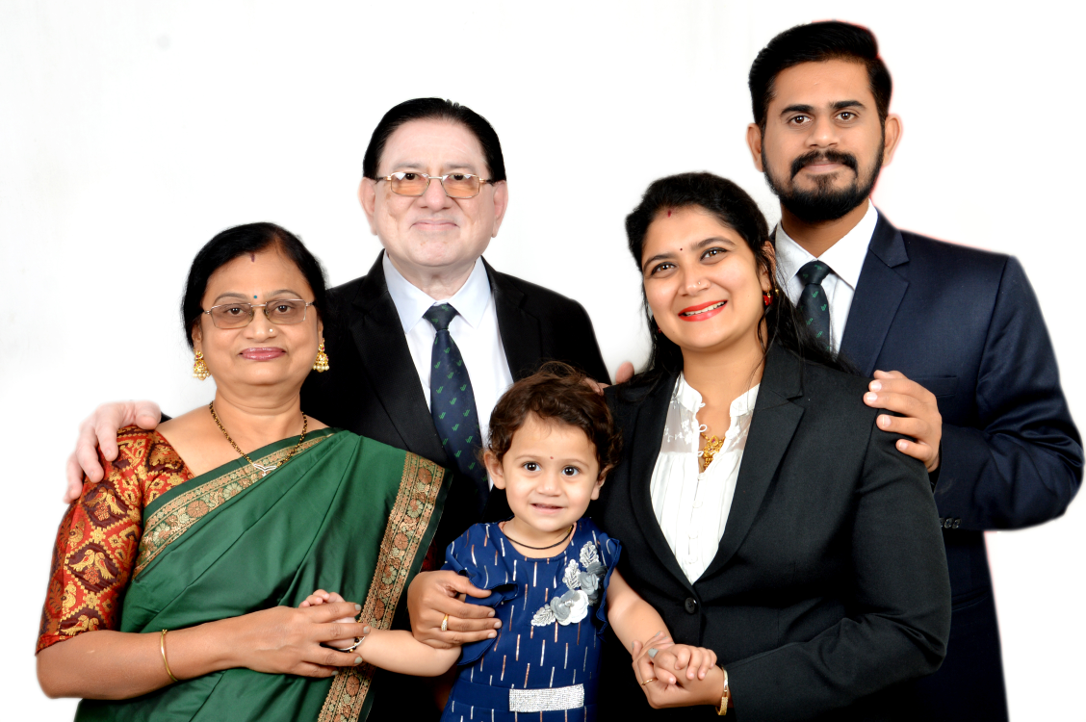
500 Pv cIRcle
Sandeep Deshpande
(DUCD)

Slide 2
Why are you doing business ?
LONG TERM
SUSTAINABLE
PROFITABLE
DUPLICABLE

Slide 3
Why – 500 PV Circle
We are in turnover based business
The most important aspect of any business – sales/ volume/ Turnover
100 PV – Consumer Mindset
500 PV – Business Man Mindset
Complete 500 PV – 1st week or every Month
Maintain Customer record ( 20-30 loyal consumer), CNC
Keep Stock – 15-20 k in your House

Slide 4
WHY 500 PV CIRCLE
BUSINESS START
30 PV – 10 YEARS
100 PV - 5 YEARS
160 PV – 2 TO 3 YEARS
300 PVS – 1 TO 2 YEARS
500 PVS - 6 MONTHS TO 1 YEAR.

Slide 5
BENEFITS OF 500 PV (16000/-Rs Products)
1.MRP Dis - 10 to 20 % 2400/-
2.Cash Back 8% 700/-
3. Free products 10% 1600/-
4.CNC offer 3000/-(MRP)
Total 7700/-
5. Fast track 8 % 750/-
G.Total 8450/-

Slide 6
1st Month
YOU
500 Self PV
500 pv
500 pv
500pv
500 pv
500 pv
500 pv
500 pv
500 pv
1 x 500 pv = 500 PV
8 x 500 pv = 4000 PV
TOTAL PVS 4500 PV Fast Track Bronze Director
15000/-

Slide 7
2 nd Month
YOU
500 Self PV
500 pv
500 pv
500pv
500 pv
500 pv
500 pv
500 pv
500 pv
8 x500 =4000pvs
8 x500 =4000pvs
8 x500 =4000pvs
8 x500 =4000pvs
8 x500 =4000pvs
8 x500 =4000pvs
8 x500 =4000pvs
8 x500 =4000pvs
1 x 500 = 500 PV
8 x 500 = 4000 PV
64 x 500 = 32000 PV
Total PV = 36,500 PV

Slide 8
3 rd Month
YOU
500 Self PV
500 pv
500 pv
500pv
500 pv
500 pv
500 pv
500 pv
500 pv
1 x 500 = 500 PV
8 x 500 = 4000 PV
64 x 500 = 32000 PV
512 x 500 = 256000 PV
Total PV = 2,92,500 PV
Income 4 to 5 Lakhs
Pin : UCD
8 x500 =4000 PV
64 X 8 = 512 Members

Slide 9
BENEFITS
100 % Products Use
100 % Meetings
Stability in the business
Right Duplication
Multiple Growth
Balancing Width & Depth
No Side Volume Problem

Slide 10


